Slide 1
Day 1 Agenda
DAY
1
Introduction to Formality
1
2
Getting Started with Formality
3
Basic Formality Flow
4a
Reading Designs: Black Boxes
5
Matching
6
Verification

Slide 2
Unit Objectives
After completing this unit, you should be able to:
List 4 ways of creating a blackbox model
Give two reasons why allowing Formality to create black boxes for unresolved modules can result in a failing verification
Find black boxes using both GUI and command line
2

Slide 3
Black Boxes: What Are They?
A Black Box is a empty model for a module/entity
Black boxes DO affect verification
  Black box input pins are compare points
  Black box output pins are inputs to logic cones
  Black box pins of unknown direction are treated as inouts
3

Slide 4
Black Boxes: What Are They?
This is an Instructor Guide page!
Switch to "Notes" view.
Notes:
Black Boxes: What Are They?
Key Message/Points:
What are black boxes, and how are they created?
Technical Explanation:
Questions:
Slide Transition:
Instructional Comments:
References/Additional Information:

Slide 5
Black Boxes: Require Attention
If black box pin directions are undefined Formality:
  Attempts to infers pin direction from connectivity
  Will label the pin an I/O if it cannot infer direction
Plenty of opportunities for failing verifications!
  A cell is a black box in reference but not in implementation
  A cell is a black box in both designs, but has additional pins in reference
  A pin is an inout in reference but an input in implementation
  More details in Section 6
4

Slide 6
Black Boxes: Require Attention
This is an Instructor Guide page!
Switch to "Notes" view.
Notes:
Black Boxes: Require Attention
Key Message/Points:
What affects do black boxes have on Formality?
Technical Explanation:
Questions:
Slide Transition:
Instructional Comments:
References/Additional Information:

Slide 7
When would you want to use a Black Box?
No suitable model exists (analog cell)
No point in verifying (RAM)
You wish to exclude a sub-module from verification
  Known problem within module
  You only want to check other areas of design
5

Slide 8
How to create a black box
Before ‘read’: create a wrapper model
  Model that defines pin out but has no functionality
Before ‘read’: set hdlin_interface_only {sRAM01}
  Formality loads pin out but no functionality
Before set_top: set hdlin_unresolved_modules black_box
  Formality creates a black box for any instantiated cell that is unresolved
Before match: set_black_box i:/WORK/sRAM01
  Formality sets a black box property on the cell
6

Slide 9
Black Boxes - recommendations
Be consistent about blackboxes in ref and impl
  Unmatched blackboxes will give failing verification (in general)
Ensure no unintended black boxes
  Leave hdlin_unresolved_modules in default state of error
  (set_top will error out if there is a missing model)
Provide pin direction information if black boxes are deliberate
  Create a wrapper model
  Use hdlin_interface_only
  Use set_black_box
  Use set_pin_direction (last resort)
If you have a model and are experimenting
  Use set_black_box
  Can remove effects without reloading container
7

Slide 10
Black Boxes: Wrapper Model
/*File ram.v */
module ram (d, rw, ck, q);
input [7:0] d;
output [7:0] q;
input rw, ck;
endmodule;
Simply an empty model, but with pins defined
8

Slide 11
Black Boxes: hdlin_interface_only
You can read in just the interface information for a design
  Eliminates having to create wrappers
  Does require a description for design or module
set hdlin_interface_only RAM*
read_verilog –i gates.vg –vcs “-y ./sim_lib +libext+.v”
  The argument is the design or module name
    Not the filename
    Not the instance name
    You can use wildcards
  Works for both netlists and RTL
  Works for all input formats
9

Slide 12
Black Boxes: hdlin_unresolved_modules
Formality tcl variable that determines how to handle instances that are not resolved
  Possible values are ‘error’ and ‘black_box’
  ‘error’ means no design is created (default value)
  ‘black_box’ means Formality creates a black box
The default value of error
  Prevents you creating black boxes by mistake
  Prevents verification from proceeding
    Set_top will error out if there is an unresolved module
    If set_top errors out all subsequent steps error out too
10

Slide 13
Black Boxes: why is an instance unresolved?
Formality cannot find a corresponding module/entity
  File is missing or you typed in wrong file name
  File name and VCS options don’t match
The file for the module or entity contains
  syntax errors
  unsupported constructs
The instance and the module/entity are inconsistent
  Pinout doesn’t match
Formality analysis shows risk of simulation/synthesis mismatch
  (By default) Formality will not create a model
  See Section 4b for details
11

Slide 14
Setting a Black Box property
You can set/unset the black_box property on a design in either the REF or IMP or both
  Inputs will become new compare points, outputs will become new cone inputs
set_black_box r:/WORK/mod
remove_black_box r:/WORK/mod
report_black_boxes
“mod” is the design name, not the instance name
12

Slide 15
Black Boxes: Specifying Pin Directions
Tell Formality about the directions of black box pins:
  Find the code for the missing cell and read it in
  Find the code for the missing cell and read in only the interface information (hdlin_interface_only)
  Alternative: create a dummy definition for the black box cell containing the input and output port declarations but containing no logic
    Read this cell into Formality so that it knows the directions of the pins
  Last Resort: Use the set_direction command to set the pin directions on unresolved modules
  set_direction r:/WORK/mAlu/reg[0] out
13

Slide 16
Black Boxes: Specifying Pin Directions
This is an Instructor Guide page!
Switch to "Notes" view.
Notes:
Black Boxes: Specifying Pin Directions (1/2)
Key Message/Points:
What are three ways to tell Formality the pin directions of black boxes?
Technical Explanation:
Questions:
Slide Transition:
Instructional Comments:
References/Additional Information:

Slide 17
Finding Black Boxes using fm_shell
fm_shell (setup)> report_black_box
Information: Reporting black boxes for current reference and implementation designs. (FM-184)
__________________________________________________
| |
| Legend: |
| Black Box Attributes |
| s = Set with set_black_box command |
| i = Module read with -interface_only |
| u = Unresolved design module |
| e = Empty design module |
| * = Unlinked design module |
|___________________________________________________|
##################################################################
#### DESIGN LIBRARY - i:/WORK
##################################################################
Design Name Attributes
----------- ----------
sRAM01 s
##################################################################
#### DESIGN LIBRARY - r:/WORK
##################################################################
Design Name Attributes
----------- ----------
sRAM01 i
14
Notes:
Options to the report_black_box command correspond to the attributes: -set_block_box, -interface_only, -unresolved, and –empty.

Slide 18
Finding Black Boxes using fm_shell
This is an Instructor Guide page!
Switch to "Notes" view.
Notes:
Finding Black Boxes using fm_shell
Key Message/Points:
How do I find black boxes from fm_shell?
Options to the report_black_box command correspond to the attributes: -set_block_box, -interface_only, -unresolved, and –empty
Technical Explanation:
Questions:
Slide Transition:
Instructional Comments:
References/Additional Information:

Slide 19
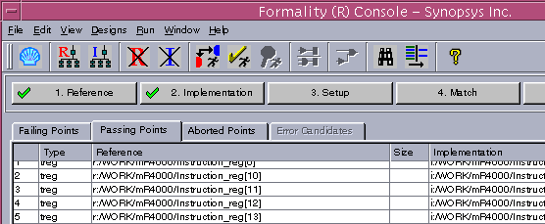
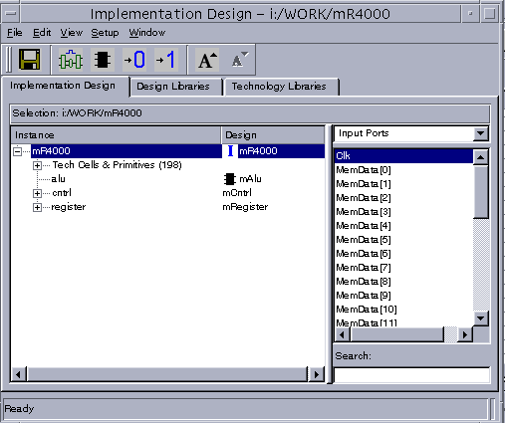
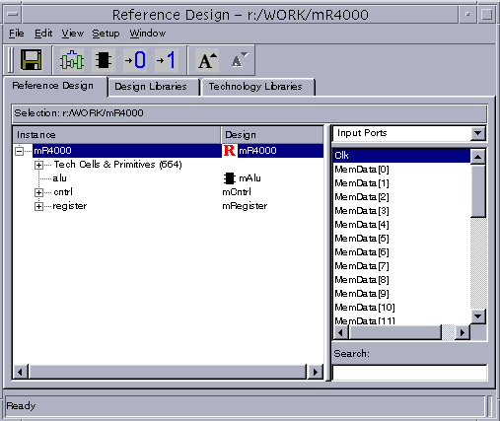
Finding Black Boxes with the GUI
15

Slide 20
Finding Black Boxes with the GUI
This is an Instructor Guide page!
Switch to "Notes" view.
Notes:
Finding Black Boxes with the GUI
Key Message/Points:
How do I find black boxes from the GUI?
Technical Explanation:
Questions:
Slide Transition:
Instructional Comments:
References/Additional Information:

Slide 21
Black Box Summary
Method | Command / Variable | report_black_box shows as
Read a Wrapper |  | Empty Module
Read in the interface only | hdlin_interface_only | Interface Only
Set a property after reading in | set_black_box (remove_black_box undoes) | Set with command
Don’t read in the design | hdlin_unresolved_modules (may need set_direction too?) | Unresolved Design Module
16

Slide 22
Review Questions
List 4 ways of creating a black box model
Which commands or variables would you use for each of these 4 ways?
Give two reasons why allowing Formality to create black boxes for unresolved modules can result in a failing verification
How would you find black boxes from the command line?
How would you find black boxes using the GUI?
17

Slide 23
Command/Variable Summary
set hdlin_interface_only <Design Name(s)> | Following read operations will read only the interface declaration for the design
set hdlin_unresolved_modules <error | black_box > | Determines how unresolved modules are handled
set_black_box <design> | Set a black box property on a design
remove_black_box <design> | Removes a black box property from a design
report_black_box | Lists black boxes and shows source of black box
set_direction <pin> | Set pin direction on a black box (use on unresolved modules)
18

